Slide 1
ENERGY DEMAND AND PRICE FORECASTING
INFOSYS SPRINGBOARD
Submitted by: Prachi Wadhave
Date : 19 July 2024

Slide 2
Problem Statement
The focus lies in building predictive models that incorporate diverse data sources, including historical demand patterns, weather variables, and other relevant factors.
Predict electricity demand and price to support smart grid operations and data-driven decision-making in the energy market.

Slide 3
Content
Data Introduction
Exploratory Data Analysis
Feature Engineering
Data Visualization
Model implementation
Model selection
Conclusion

Slide 4
Data Introduction
Energy Dataset:
Historical electricity demand and price data essential for analyzing past consumption patterns and pricing trends.
Shape of energy dataset:
columns:29
rows:35064
Weather features:
Historical and forecasted weather data, including temperature, humidity, wind speed, and other meteorological factors crucial for accurate demand forecasting.
columns:17
rows:178396
Merged dataset: after merging both datasets
columns:45
rows:178396

Slide 5
Exploratory Data Analysis
Clean and format data, handling missing values and outliers.
Visualize relationships between demand, price, and influencing factors.
After cleaning of data and merging of two datasets by aggregated function(35064,36)
Handling of missing values(9.55%) by various techniques like mean , mode, median , forward filling and backward filling.
Create new features from existing data if needed, such as aggregations, transformations, or interactions between features.(peak-status , days of week , month)
Boxplots used to Identify outliers and understand the spread of the data.

Slide 6
Feature Engineering
Binary Encoding : for categorizing the high peak and off-peak by representing the high peak by 1 and off-peak by 0.
Binary Encoding : it categorize the weekdays and weekend in binary form.
One-hot Encoding : process that converts categorical variables into a binary matrix representation helps to categorize the months.
Mapping is the process of transforming data values using a specified function or dictionary in a single line.it helps to describe the weather description.

Slide 7
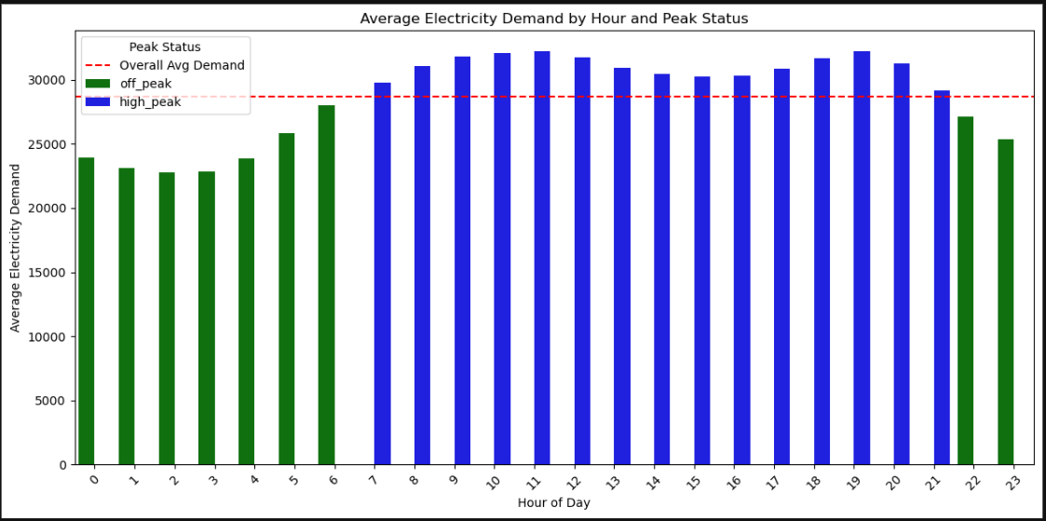
Data Visualization
Barplot of Average electricity demand by hour and peak-status
Electricity demand tends to be higher during peak hours (high-peak hours) compared to off-peak hours throughout the day.This is particularly noticeable during late afternoon and early evening hours , where demand peak above the overall average demand indicated by the we dashed line

Slide 8
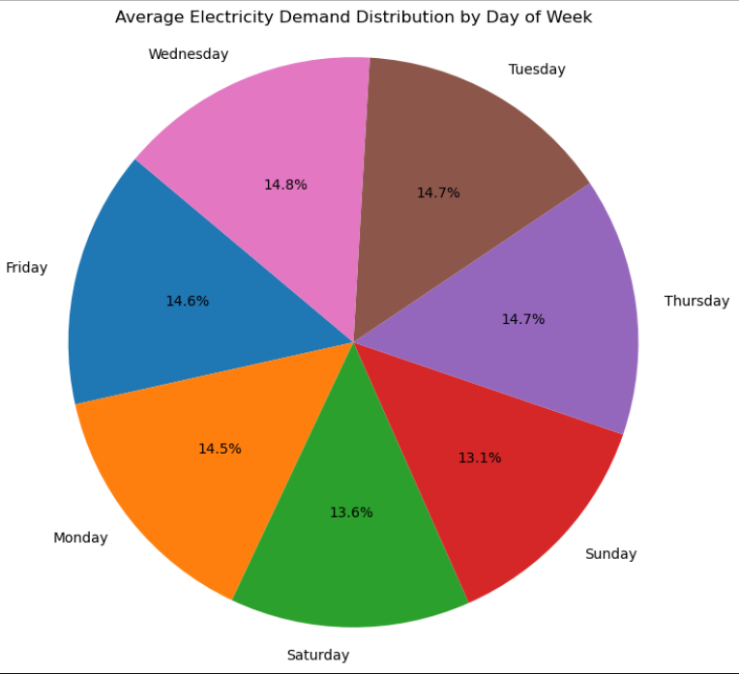
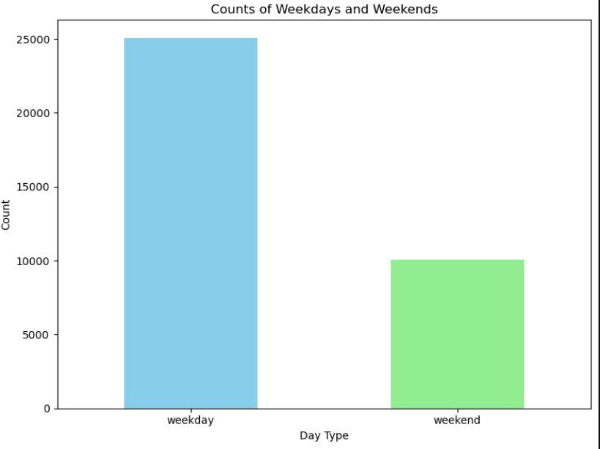
Barplot for counts of weekdays and weekends
Pie chart Average Electricity demand distribution by days of week
Weekdays have a notably higher count compared to weekends in the dataset, indicating that there are more data points recorded during typical working days compared to weekends,
The pie chart visually represents the distribution of average electricity demand across different days of the week.

Slide 9
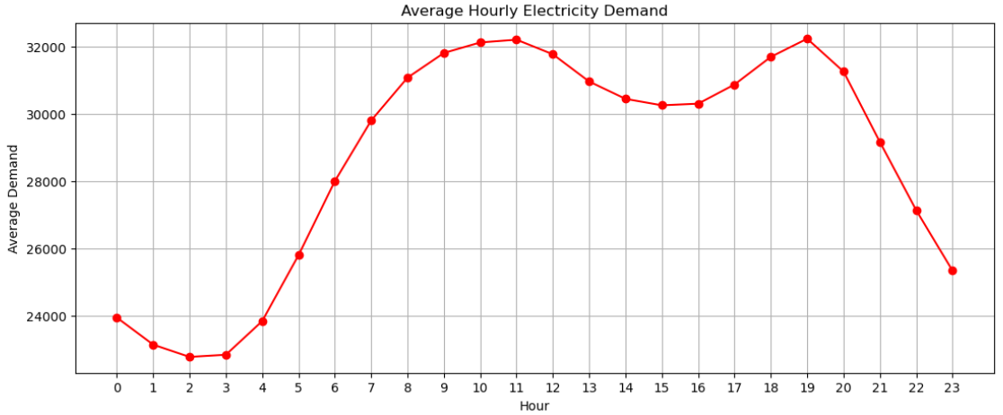
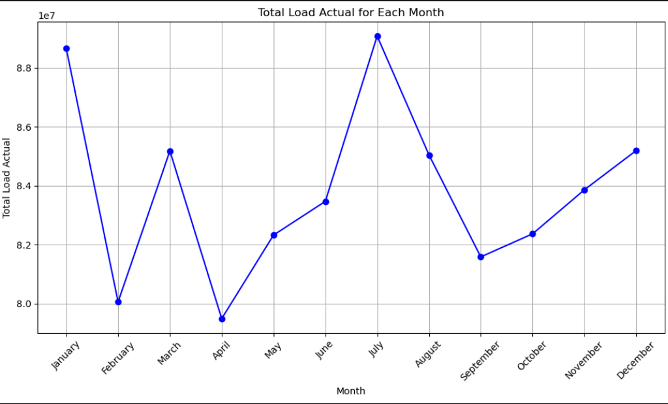
Average hourly Electricity Demand
Total actual load for each month
The graph shows that electricity demand peaks during the late afternoon and early evening hours, indicating higher usage during these times.
he plot shows how electricity demand varies throughout the year, with potential peaks during certain months indicating higher energy consumption periods, likely influenced by seasonal factors such as weather conditions or economic activities.

Slide 10
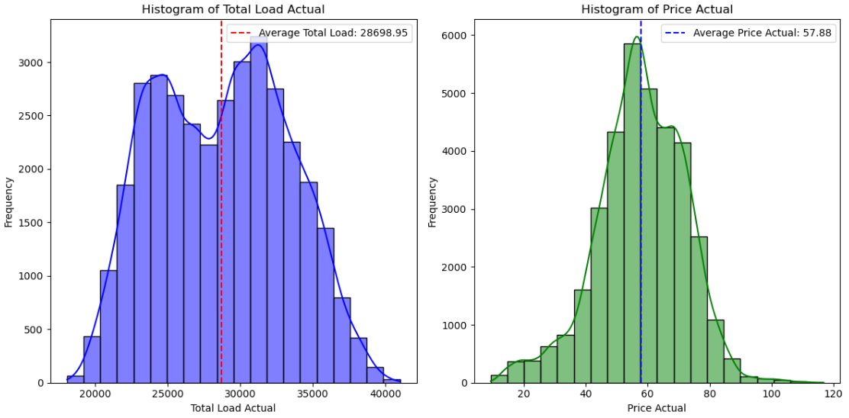
Histogram for load and price
These histograms reveal that the distribution of total electricity load shows a moderate skew towards higher values, while the distribution of actual prices appears relatively symmetric with a slight tail towards higher prices.

Slide 11
Implementation
Model Training :
Use train data to evaluate different models.
we use train ,test and validation to split the data into 70% and 30% where we take 50% of 30% for test and validation.
We select the features from the correlation matrix with the threshold value 0.2.
Model Evaluation :
Choose the best performing model based on evaluation metrics values from test data.
Evaluation metrics: MAPE , MAE , RMSE , Adjusted R^2,R^2.
Evaluate the model on unseen data to assess generalizability.

Slide 12
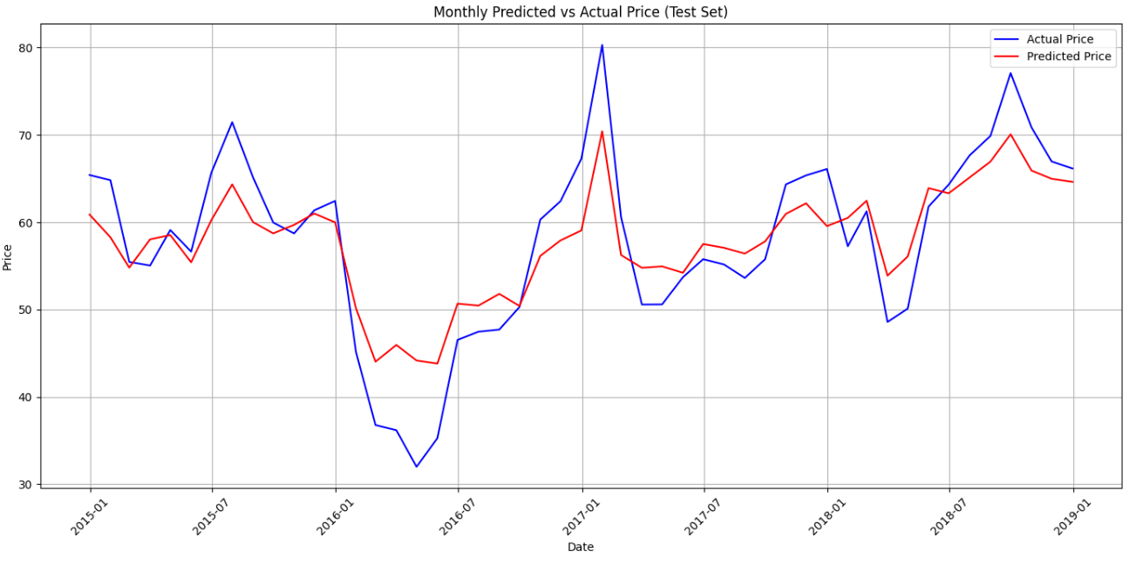
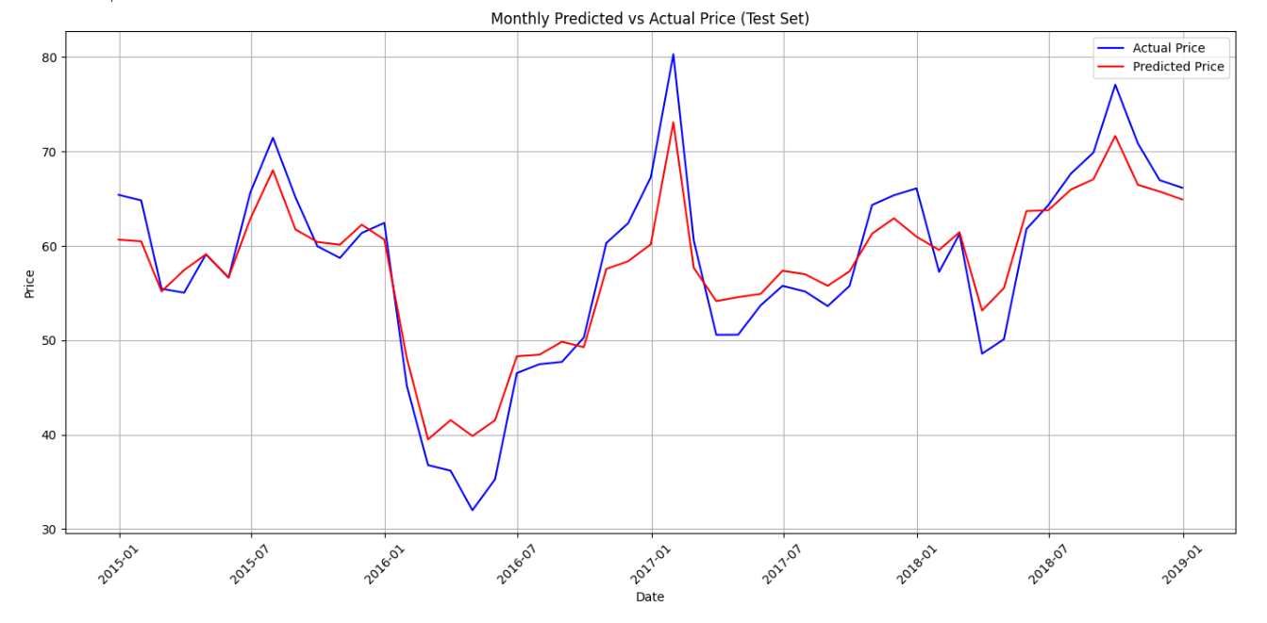
Plots for all model (Actual vs Predicted)
Linear regression model :
Random Forest:
Test for price actual (Linear Regression)
Test MAE for price actual: 6.239635816
Test R² for price actual: 0.60821391554
Test Adjusted R² for price actual: 0.60765443
Test MAPE for price actual: 0.12941150046
Test RMSE for price actual: 8.9351705555
Test for price actual
Test MAE for price: 4.590407414448669
Test R² for price: 0.7496740279566747
Test Adjusted R² for price: 0.7492926878107455
Test MAPE for price: 0.09511543154946828
Test RMSE for price: 7.142188352220828

Slide 13
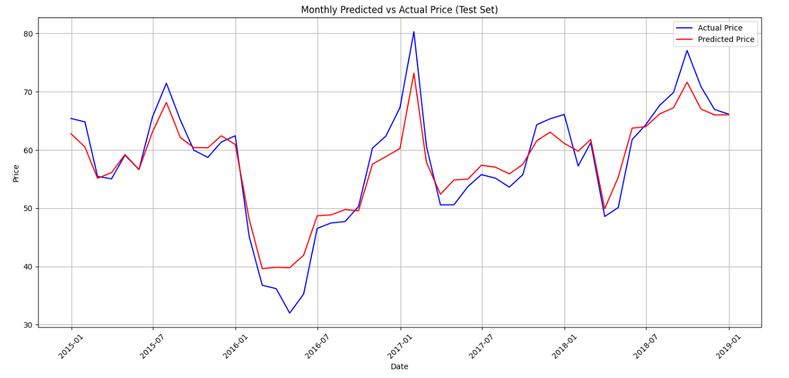
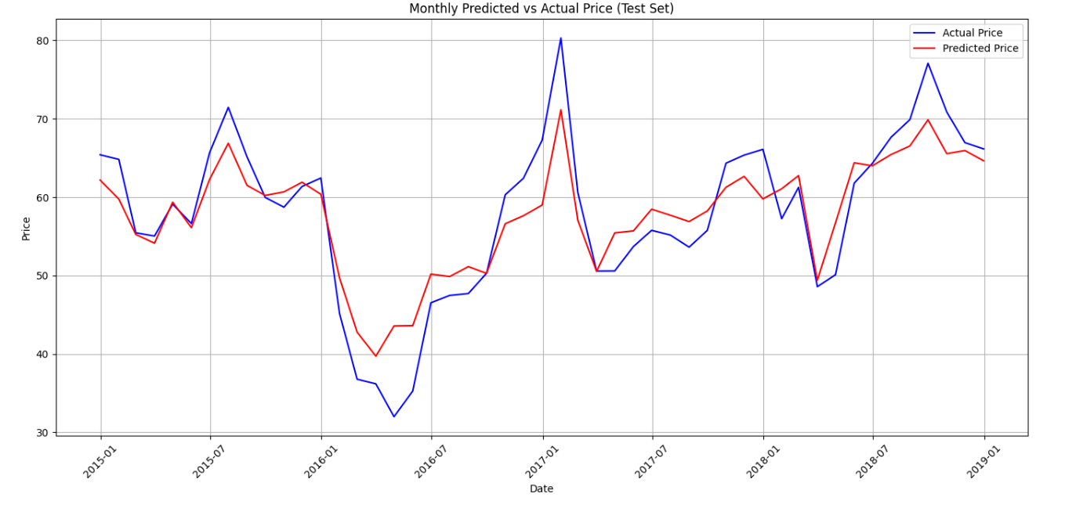
Hyperparameter tuning of Random Forest :
Gradient boosting:
Test for price actual (Hyperparameter tuning RF)
Test MAE for price: 4.399176425855513
Test R² for price: 0.7684679656642905
Test Adjusted R² for price: 0.7681152557195727
Test MAPE for price: 0.09061540913344888
Test RMSE for price: 6.868847704412615
Test for price actual (Gradient Boosting)
Test MAE for price actual: 5.3889438523514
Test R² for price actual: 0.6879913735071495
Test Adjusted R² for price actual:0.6875160675922789
Test MAPE for price actual: 0.11188656493507634
Test RMSE for price actual: 7.973732175433088

Slide 14
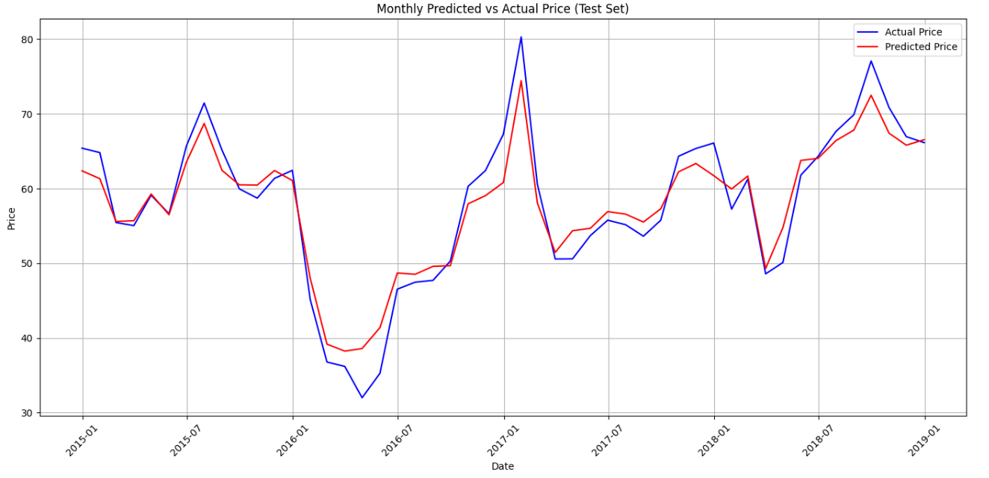
Hyperparameter tuning of Gradient Boosting:
Test for price actual
Test MAE for price actual: 4.20306066709919
Test R² for price actual: 0.7926182230154943
Test Adjusted R² for price actual: 0.7923023029515363
Test MAPE for price actual: 0.08524048042600126
Test RMSE for price actual: 6.5007526132919375

Slide 15
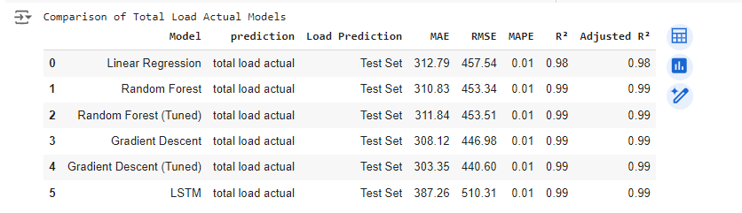
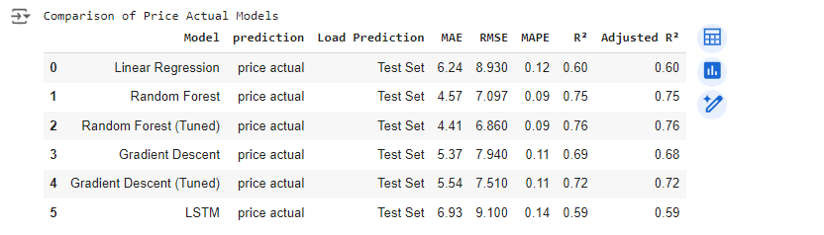
Model Selection
for load model we finalize the Hyperparameter of Gradient Boosting model beacuse in compare to other models its produce the less mape value is 0.010602 and the lowest MAE value :303.3579
for price model we finalize the Hyperparameter of Random Forest with the best MAPE value in comparison to others is : 0.090833
MAE evaluation is : 4.411 as compare to other it is the lowest value
RMSE value : 6.869

Slide 16
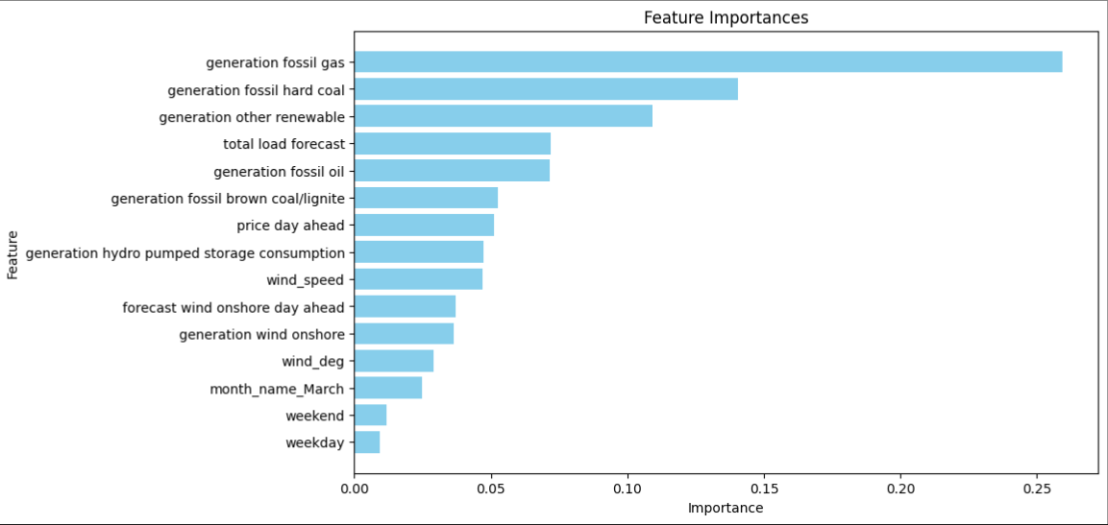
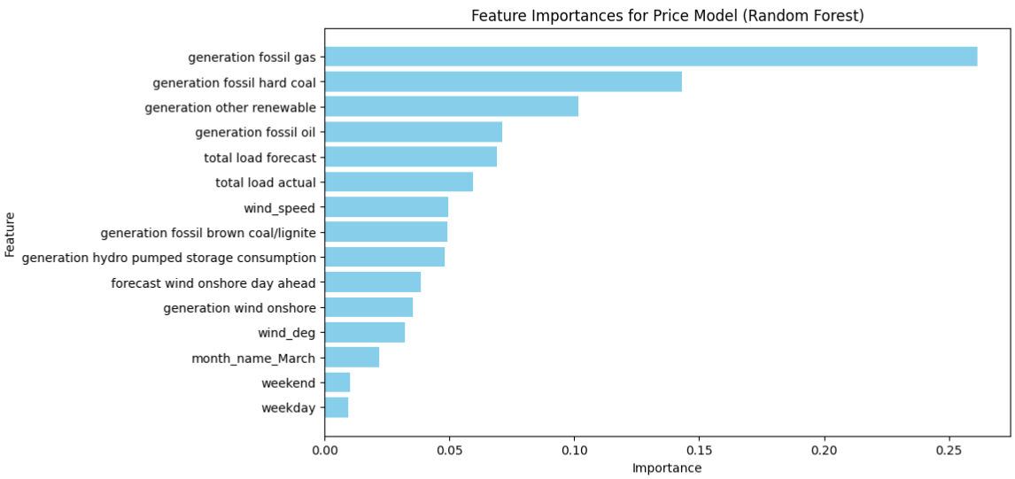
Conclusion
By comparing all the evaluation metrics with the help of comparison table of all models we get the finalize model for load model and price model.
For load model : we select the Gradient boosting(Tuning) with the MAPE value (0.01049).
For price model : we select the Random Forest(Tuning) with the MAPE value (0.08862).
After selecting model we find the important features by ploting a graph.
For load model:Gradient Boosting(Tuning)
For price model : Random Forest(Tuning)

